Slide 1
Clinical Variability
2022 Semester 2
Group 29
Zhiyuan Chen
Zhi Hern Tom
Ya Cho
Suyi Jiao
Zhuoling Chen
Notes:
Hello everyone, we are group 29
Today we will give presentation about our Clinical Variability Project.
IntroductionThis includes an introduction to the client, the data science problem and group members
4 pts
This criterion is linked to a Learning OutcomeThe project in detail : Data Science workflow explained / EDA included; implications discussed
4 pts
This criterion is linked to a Learning OutcomeThe project in detail : Methods – justification included; description clear; mathematical rigour at the expected standard
4 pts
This criterion is linked to a Learning OutcomeThe project in detail : Results and Conclusion – valid and informative -- are the results of interest to the client/host and to the wider Data Science community?
4 pts
This criterion is linked to a Learning OutcomeThe presentationThis includes presentation technique, use of visual aids. Was the presentation 'read from a script'? Did the group 'engage' with the audience? Did all group members contribute? Penalty -1 mark per minute if presentation greater than 15 minutes
4 pts

Slide 2
Team introduction
Zhiyuan Chen
Team leader
Main communicator
Zhi Hern Tom & Ya Cho
Data processor
Data visualizer
Suyi Jiao & Zhuoling Chen
EDA contributor
Notes:
Firstly let me quickly introduce our group.
Zhiyuanchen is the team leader and also the main communicator to bridge between the group and the client; Tom and i take the main responsibility for data preprocess and visualiziation; while suyi jiao and zhuoling chen are incharge of the main part for the exploratory of data analysis.

Slide 3



Client introduction
Dr Daniel Capurro:
Deputy Director of the Centre for Digital Transformation of health
Dr Timothy Fazio:
Head of unit for metabolic disease unit
Chief Medical Information Officer in EMR
Professor Rinaldo Bellomo:
A legend in field of intensive care medicine
Notes:
During our project, we are excited to work with our client
Daniel Capurro was the first client we get to see He is a senior lecturer in Digital health and Deputy Director of the Centre for Digital Transformation of health. His main interest lies in developing methods to improve the use of clinical data for research through the usage of AI and process mining techniques.
Timothy Fazio is a specialist physician and certified health informatician. He has worked in RMH for over 11 years and he’s currently the head of unit for metabolic Disease Unit.
Professor Rinaldo Bellomo is the an extremely renowned person in the medicine field and his list of accomplishment is simply remarkable. He was awarded Officer of the Order of Australia for distinguished service to intensive care medicine. He is a senior researcher and staff specialist in intensive care at RMH.

Slide 4
Clinical variability
Definition
Difference in healthcare processes or outcomes, compared to peers or to a standard
Importance
Detect on unwanted variation to provide clinical suggestion and improve it
Project aim
Generic method to quantify and visualize the clinical variability
Comparative analysis between the two dataset MIMIC and EPIC
Notes:
Clinical variability is defined as the difference in healthcare processes or outcomes, compared to peers or to a gold standard such as an evidence-based guideline recommendation. While a certain amount of variation can be beneficial for the patient as hospitals can offer patients different needs based on their health status or their preferences. It is the excessive or unwarranted variation that we should be focusing on and try to improve upon as they can lead to adverse effects.
In this project, our aim is to create method that’s able to quantify the clinical variability of patient during their patient’s stay in the hospital using MIMIC dataset. So that these methods in the format of scripts can be replicated by Rinaldo and Tim onto their own RMH EPIC dataset. The final approach that we went for is perform a comparative analysis between the two dataset MIMIC and EPIC in a form of EDA.

Slide 5
Clinical variability
Challenge
Conflict of definition for variability
Lack of medical knowledge lead to difficulty in interpretation
Time constraint
Notes:
While the approach sounds very simplistic, this is because we have faced many challenges during the project. For starter, there is a conflict of definition for variability between our client. While Daniel would like to approach the problem using process mining approach. Rinaldo and Tim prefer looking at variability at finer scales. Secondly, our team has no background in the medicine domain which makes interpretating results very difficult. Finally, we have only received the EPIC dataset at the very end of our project which makes the time to analyse our result very time constrained. Next, we will discuss the methodology section in detail which will be handled by Zhiyuan.

Slide 6
Overview of MIMIC & EPIC
MIMIC(Medical Information Mart for Intensive Care)
Records de-identified patient data from a Medical centre in Boston USA
This project uses the fourth iteration MIMIC-IV v1.0
Three main modules: core, hosp, icu
RMH EPIC
From The Royal Melbourne Hospital
De-identified dataset for CABG cohort
Include 5 sheets:patients, admissions, icu_stays, bypass_surgeries, hemoglobin, transfusion
Notes:
Slide overview of MIMIC and EPIC dataset
Before I jump into the methodology, I would give a quick overview on the source of our dataset. First, we have MIMIC which stands for the Medical Information Mart for Intensive Care. It is a database holding deidentified electronic medical records with patients who stayed in ICU at Beth Israel Deaconess Medical Center in Boston USA. In terms of data our version of MIMIC splits data that’s relevant to us into 3 modules. The core module that contains patient’s demographics and admission info. The hosp and icu modules each tracks patient’s medical info during their stay in the hospital and in the icu.
Then we have the RMH EPIC dataset, this database contains identified EMR from patient’s presumably in Royal Melbourne Hospital. The reason why I said presumably is because we don’t actually know what the entire database looks like since the full dataset is reversed for highly qualified researchers because of the privacy concerns. So in this project we’re given a small sample of the patient’s records in EPIC that has been manually deidentified by the Tim and the data only contains output thats deemed relevant to our EDA comparison in their point of view.

Slide 7
Workflow
Acquire and familiarise MIMIC
Identify variable of interest
Readjust method of quantifying variability
Visualise and analyse variable of interest
Complete prerequisite course to acquire dataset
Use online resource and help of experts to better understand MIMIC
Using the entire dataset is not applicable
Selected a cohort who have underwent CABG
Change the methods from using process mining perspective into using EDA
Visualise association between variables that were asked by medical experts
Explore other forms of association related to medical expert’s interest
Notes:
While MIMIC-IV is a public dataset, it is not publicly available to the general public, we would first need to complete a prerequisite course before being given the access. we decide to use google bigquery as the platform to conduct data analysis because MIMIC is very big so it’s not feasible to download it into our own device. Since MIMIC is been managed by MIT laboratory, familiarising the dataset is made easier as it has detailed documentation including a complete data dictionary and online tutorial which were very helpful. The next step was identifying our variable of interest.

Slide 8
CABG cohort
MIMIC
Diagnosis Code as Bypass Anastomosis For Heart Revascularization
Procedure as first priority
Admission type is not urgent, EW EMER or DIRECT EMER
892 patients
EPIC
Dataset for CABG cohort
268 patients
Notes:
Daniel advises us to focus on one disease type or surgery procedure because patient’s activity in hospital is dynamic and complex. And we were recommended with CABG since it’s a surgery that has a large sample size and patients have sufficient records of blood transfusion during the surgery. The way we selected these patients in MIMIC is that these patients need to have CABG been the top priority of why they were admitted to the hospital, the admission type has to be a non-emergency and the patient isn’t dead during their hospital stay. And the total cohort contains 892 patients. For Epic, the queried result was given to us and there were 282 patients. The next step is created methods of quantifying variability and this is where we face the most amount challenges.

Slide 9
Methodology
Process mining perspective
EDA perspective
1. Learning about MIMIC
2. Modelling their trajectory as a sequence of events
3. Proposing ways to describe how variable the processes are.
4. Attempt to associate different variability patterns with patient outcomes.
Complete starter questions send by Rinaldo and Tim
Report back the findings for these questions and get insight from medical experts
Formulate more questions based on these insights
Repeat step 2 and 3
Notes:
The next step is created methods of quantifying variability and this is where we face the most amount challenges. The original aim of was to use trying to explain clinical variability using process mining techniques. This is why we use Daniel was the first client working with us because he was a specialist within that domain. And our method of was as follow.
1. Learning about MIMIC which we’ve done
2. Modelling their trajectory as a sequence of events, this means to construct an event log for each patient Which we’ve also done
3. Proposing ways to describe how variable the processes are. This step we’ve also done at the end of the semester one with our proposal with how to quantify the variability.
4. Attempt to associate different variability patterns with patient outcomes.
However, after Rinaldo and Tim from RMH had read about our proposal, they are unsatisfied with the process mining approach because they think process mining looks at the patient’s variability too generally. And instead of trying to describe all of the variability using a process model. they would like to look at a bit more nuanced analysis. This means looking at shorter traces of activities and more fined grained variability.
Keep in mind that when Tim and Rinaldo made this decision, it was during the halfway point of our project. So due to the constraint of time, our methods of approaching the comparative analysis is very simple. First, Tim and Rinaldo gave us starter questions that they would like us to query using MIMIC and these questions are scoped around variability associated with blood transfusion and haemoglobin values. Next, we visualise the said queries and present our finding which medical interoperate to see if it makes sense in the real world. They would also suggest other things that they deemed interesting to analyse further and we would do so if possible. Now what would be a great things to do would be repeat step 2-3 multiple times to we can get a lot of feedback to make sure we’re on track as well as lot more questions to explore. Coming up questions on our own is very difficult because none of us have any background in medicine. Unfortunately, this is what we have to do because the medical experts are extremely busy and they did not give us anymore questions after our initial meeting. In this presentation however, we will mostly show questions that were asked by the medical experts.

Slide 10
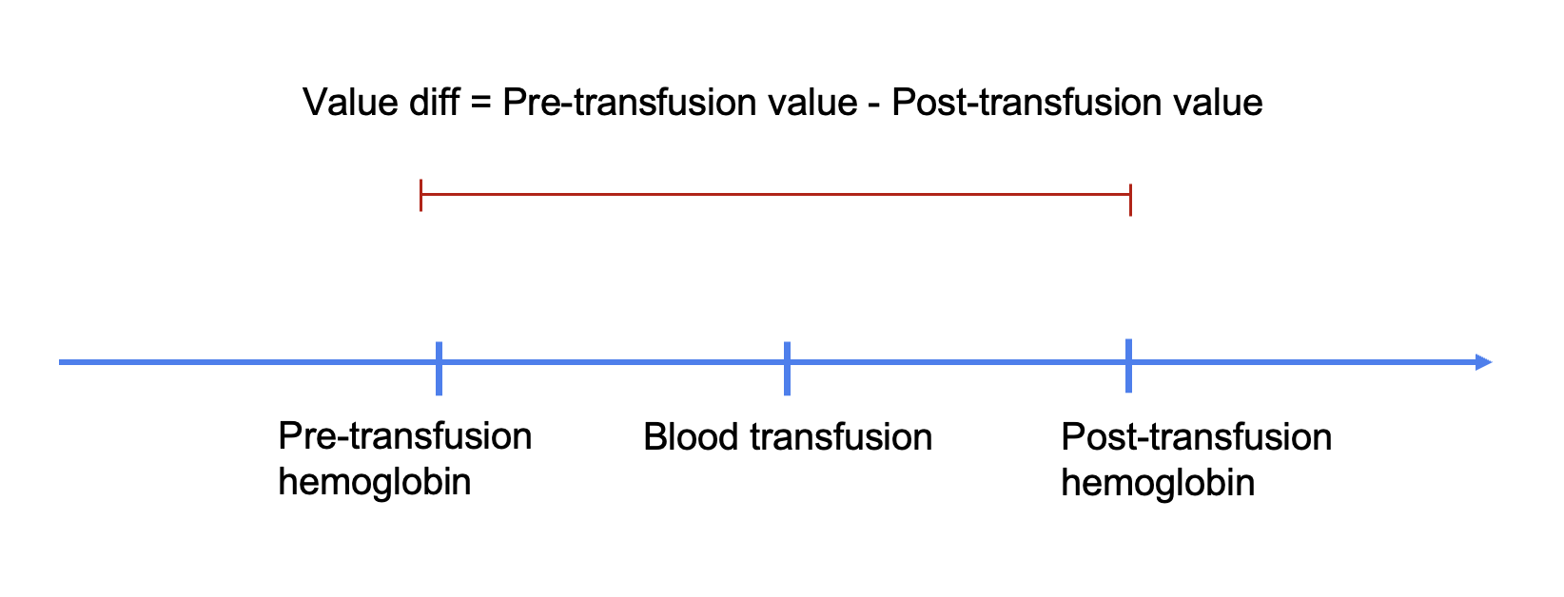
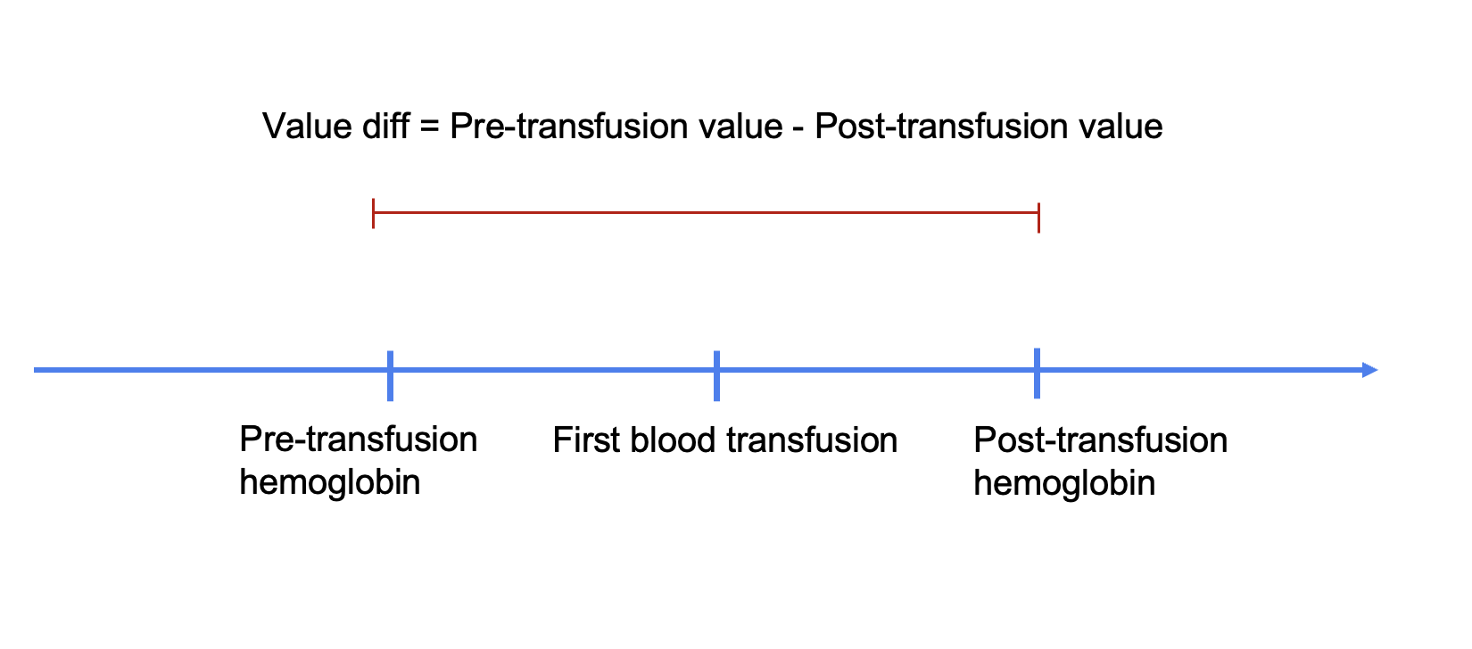
Measurement
Notes:
Before I pass it to Suyi, I would just want to mention some of our terminology because the label might cause some confusion. When we say pre-transfusion, we mean most recent hemoglobin value measured before any blood transfusion was given. And the post-transfusion is the first hemoglobin value that was measured after blood transfusion was given.

Slide 11
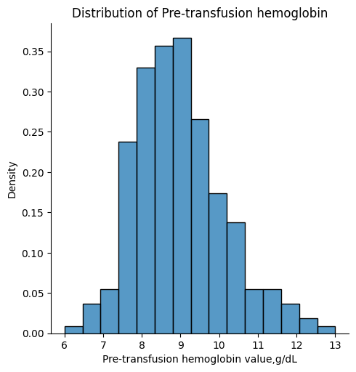
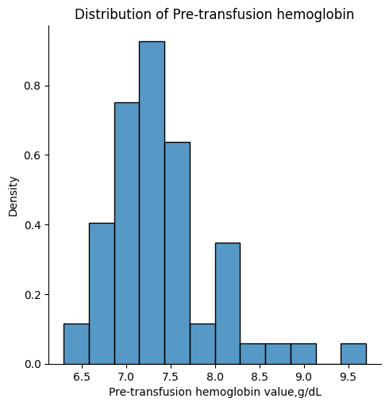
EDA
Distribution of Pre-transfusion Hemoglobin
In patients having open heart surgery after they have left the operating room, what is the last measured red cell level (expressed as hemoglobin and typically abbreviated as Hb) before the first blood transfusion is given?
MIMIC
EPIC
Notes:
This section is for EDA of MIMIC dataset and EPIC dataset. Since we want to identify patients who have done both transfusion and hemoglobin measurement for EDA, only 234 patients in the MIMIC dataset are eligible and only 63 patients in the EPIC dataset are eligible. Therefore, we perform the analysis for these patients only.
In the MIMIC dataset, we can see that most of the patients have hemoglobin values in the range of 8-9 before the first blood transfusion. In the EPIC dataset, most of the patients have hemoglobin values in the range of 7-8 before the first blood transfusion. Overall, the difference between these two datasets is not large, with most patients having a hemoglobin value of about 8 before their first blood transfusion.

Slide 12
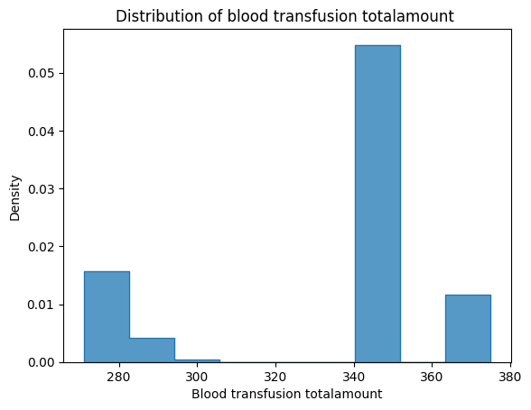
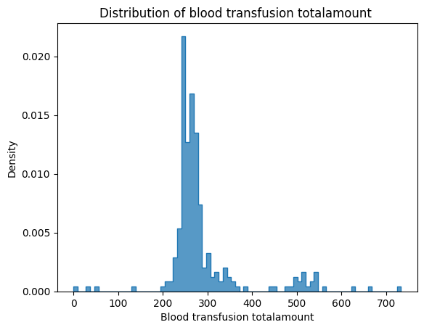
EDA
Distribution of Blood Transfusion Amount
In patients having open heart surgery, after have left the operating room, when the first act of blood transfusion is performed, how many units of blood (also called red cells or packed red cells) are given?
MIMIC
EPIC
Notes:
In the MIMIC dataset, during the first blood transfusion, the majority of patients are given red cells in the range of 340-370. In the EPIC dataset, most patients are given red cells in the range of 230-300. From these two datasets, it can be seen that most patients were given about 300 red cells during their first blood transfusion.

Slide 13
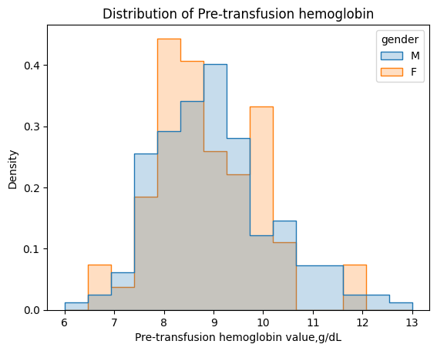
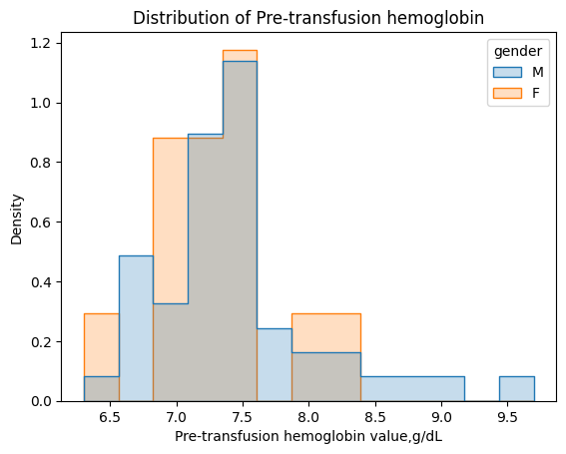
EDA
Distribution of Pre-transfusion Hemoglobin
In patients having open heart surgery after they have left the operating room, what is the last Hb before a blood transfusion is given in men compared with women?
MIMIC
EPIC
Notes:
In the MIMIC dataset, the difference in the last hemoglobin measurement between male and female patients before the blood transfusion is not very large, around 9 in male patients. In the EPIC dataset, we can draw the same conclusion. The distribution of male and female patients is roughly the same, with male patients having the last hemoglobin measurement around 7 before the blood transfusion.
Next part is for Zhuoling.

Slide 14
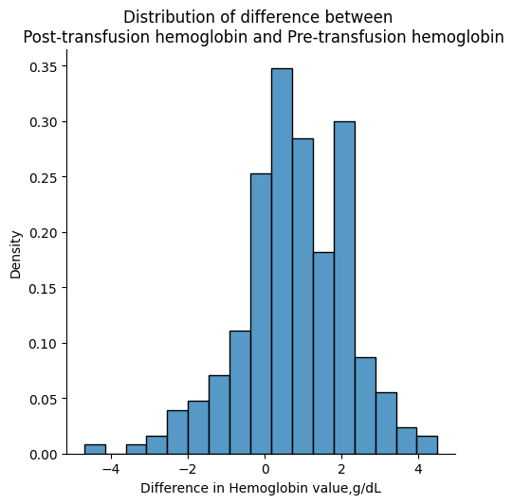
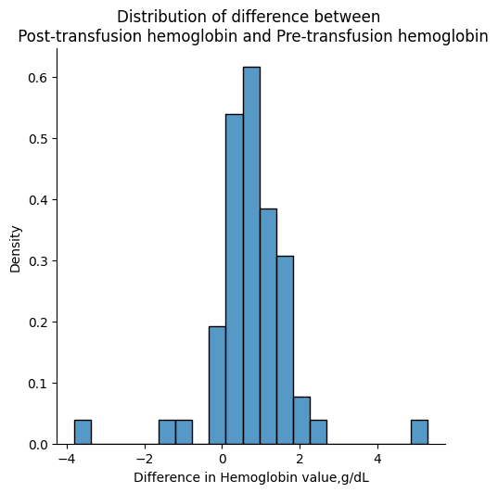
EDA
Distribution of Difference between Post and Pre-transfusion Hemoglobin
In patients having open heart surgery after they have left the operating room, what is the last Hb before a blood transfusion is given in men compared with women?
MIMIC
EPIC
Notes:
These two histograms are used to show that for patients who finished their open-heart surgery, after they left the operating room, what would be the difference between the first hemoglobin after the blood was given and the last hemoglobin before the blood was given. According to our analysis, the average for the difference is around 0.78 for MIMIC dataset and is 0.76 for EPIC. For both MIMIC and EPIC, the majority of patients have the difference value between 0 and 2, and patients in MIMIC dataset have a larger variation of difference in Hemoglobin than patients in EPIC.

Slide 15
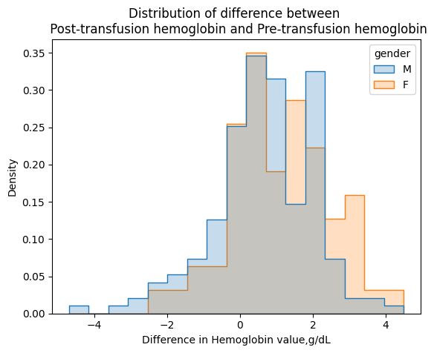
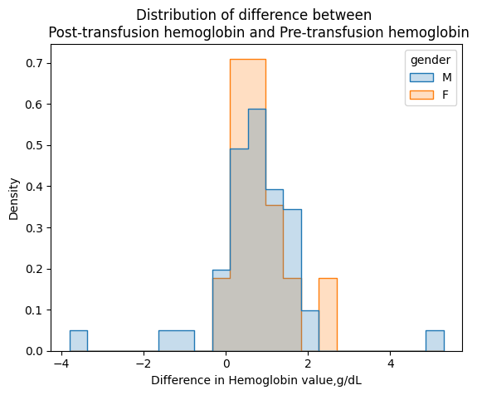
EDA
In patients having open heart surgery, after they have left the operating room, what is the difference between the first Hb after a single unit of blood was given and last Hb before it was given in men compared with women?
MIMIC
EPIC
Notes:
These two histograms are used to describe that for patients who finished their open-heart surgery, after they left the operating room, among different gender, what would be the difference between the first Hemoglobin after a single unit of blood was given for each patient and last Hemoglobin before it was given to patient. According to our analysis, for both MIMIC and EPIC dataset, female patients have a slightly larger difference value than male patients. Same as above, patients in MIMIC dataset have a larger variation of difference in Hemoglobin than patients in EPIC.

Slide 16
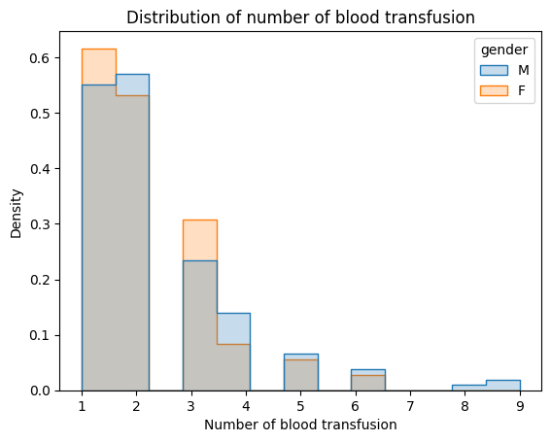
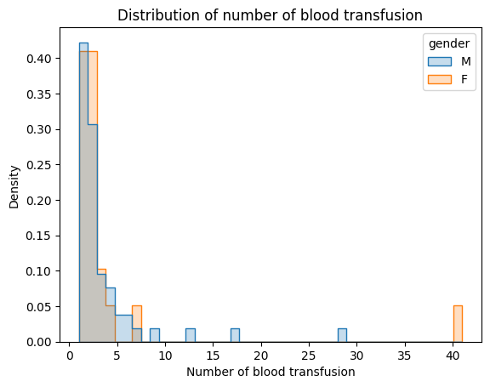
EDA
Difference in Blood Transfusion between Gender
Do men and women receive the same amount of blood transfusion?
MIMIC
EPIC
Notes:
This section is for EDA of MIMIC dataset and EPIC dataset. Since we want to identify patients who have done both transfusion and hemoglobin measurement for EDA, only 234 patients in the MIMIC data are eligible and only 63 patients in the EPIC data set are eligible. Therefore, we perform the analysis for these patients only.
In this slide we discuss the issue whether men and women receive the same amount of blood transfusion. In the MIMIC dataset, we can see that the amount of blood transfusion is almost the same for males and females. In the density plot, males and females have the similar distribution in terms of the amount of blood transfusion. In the EPIC dataset, we can draw the same conclusion. The density plot shows that males and females have the similar distribution. Therefore, from these two datasets, men and women receive the same amount of blood transfusion.

Slide 17
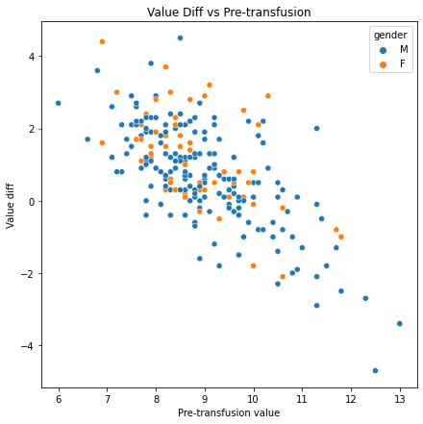
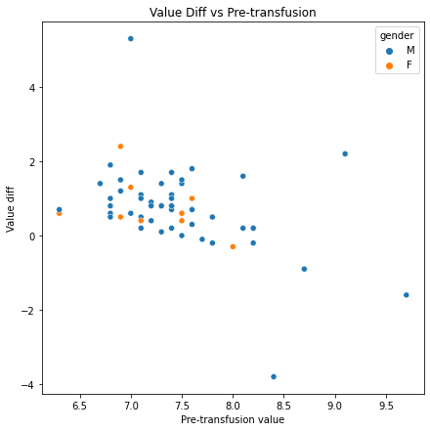
EDA
Relationship between Value Diff and Pre-transfusion
MIMIC
EPIC
Notes:
This slide focuses on the relationship between value diff and pre-transfusion(p ri transfusion). In the MIMIC dataset, there are some outliers in the plot, but this does not affect our ability to determine trends and changes in the data. From the plot, we can see that value diff and pre-transfusion are strongly correlated. When the value of pre-transfusion increases, the value diff decreases. Therefore, they have a very strong negative correlation. In the EPIC dataset, we can see that the number of patients is smaller than the number of patients in the MIMIC dataset. From the plot, we can see that value diff and pre-transfusion are not correlated. When the value of pre-transfusion increases, most of the value diff are in the interval of 0-20. Therefore, the relationship between value diff and pre-transfusion in these two datasets is different.

Slide 18
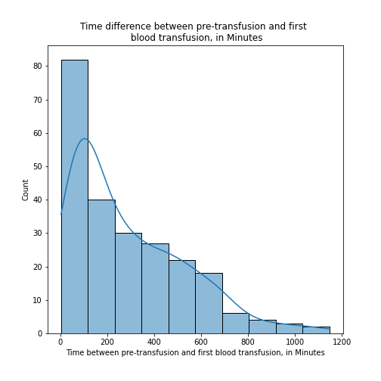
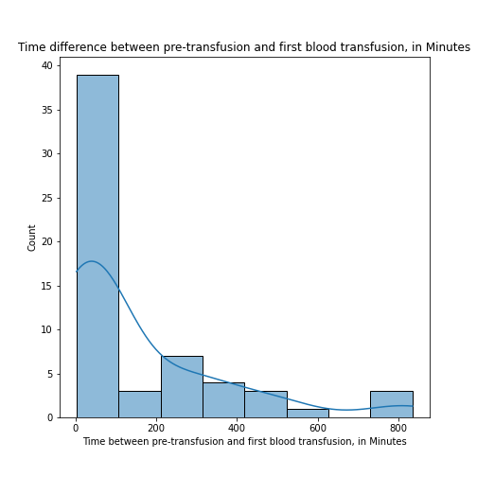
EDA
Time Interval between Pre-transfusion and 1st Blood Transfusion (in Minutes)
What is the time interval between pre-transfusion and the first blood transfusion?
MIMIC
EPIC
Notes:
In addition, the time difference between blood measurement and blood transfusion was also important. Thus we have plotted the time difference between pre-transfusion, first blood transfusion as well as post-transfusion. According to the figures, it is notable the median of the time difference between pre-transfusion and 1st blood transfusion for MIMIC dataset is around 200 minutes while the EPIC has a median of around 50 minutes. Comparing to the MIMIC’s right skewed distribution, EPIC tends to have a spike at around 250 and 800 minutes.

Slide 19
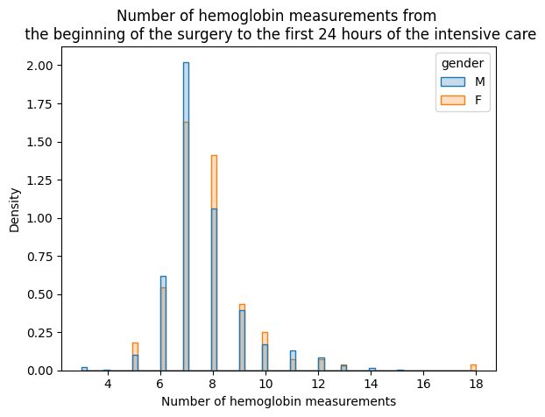
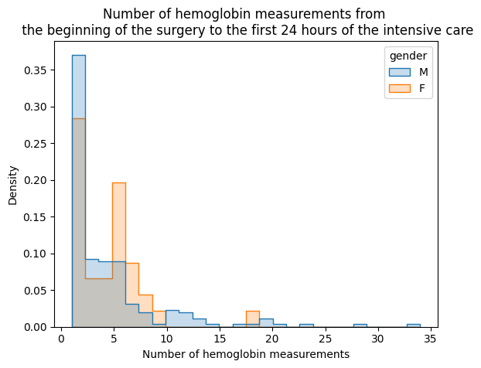
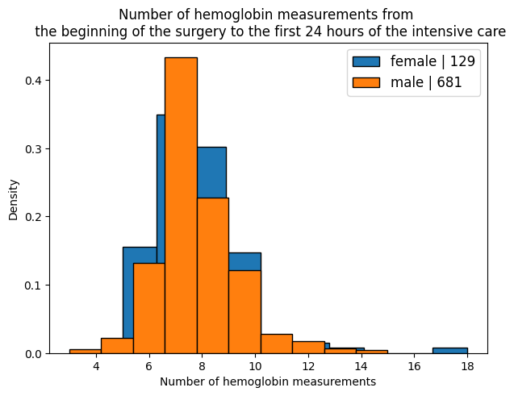
EDA
Number of Hemoglobin Measurement from the Beginning of the Surgery to the 1st 24 Hours of Intensive care
How many times the hemoglobin was measured right from the beginning of the surgery to the first 24 hours of the intensive care?
MIMIC
EPIC
Notes:
Last but not least, it is necessary to study the number of hemoglobin measurement from the beginning of the surgery to the 1st 24 hours of intensive care. For the MIMIC dataset, most of the patients had been given around 7 measurements within 24 hours while most of the patients in the EPIC dataset had only been given around 2 measurement within 24 hours.

Slide 20
Conclusions
No differences in terms of number of blood transfusion, number of blood measurement and the effect after receiving blood transfusion.
Spikes occur at different location in terms of the time interval between blood measurement and pre-transfusion as well as post-transfusion.
Majority of patients in MIMIC dataset have a larger variation and range in data distribution than patients in EPIC dataset.
Notes:
In conclusion, there are no differences in terms of number of blood transfusion, number of blood measurement and the effect after receiving blood transfusion. Also, spikes occur at different location in terms of the time interval between blood measurement and pre-transfusion as well as post-transfusion. We can see that majority of patients in MIMIC dataset have a larger variation and range than patients in EPIC dataset.

Slide 21
Thank you!

